Slide 1
Chapter 38

Slide 2
If slides with embedded WMF files do not have text properly aligned and fitting within the text boxes, this would indicate that you do not have Helvetica font installed on your computer, and Arial font has been substituted by default. Reinstalling Helvetica will most likely solve the problem.

Slide 3
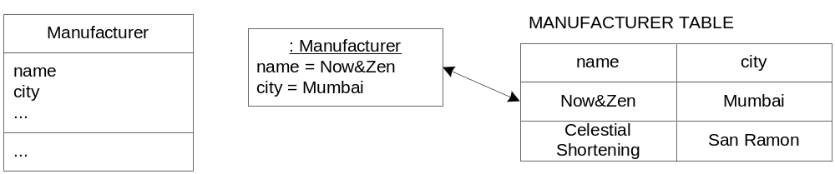
Fig. 38.1

Slide 4

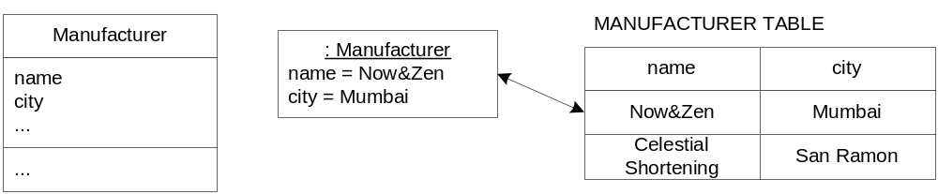
Fig. 38.1

Slide 5
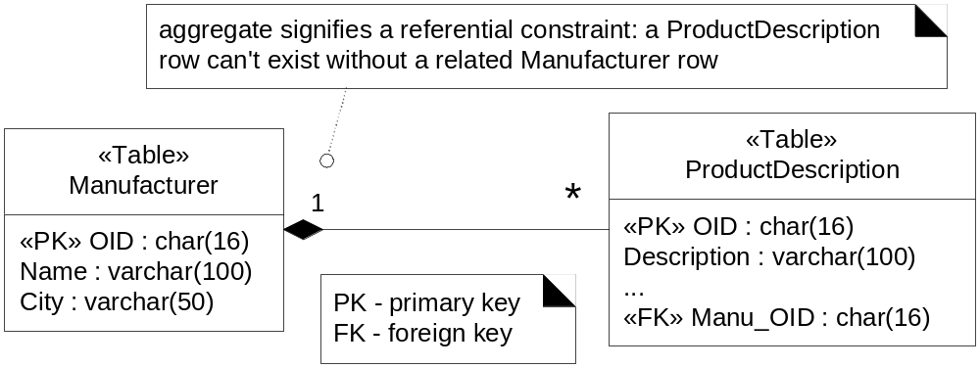
Fig. 38.2

Slide 6

Fig. 38.2

Slide 7
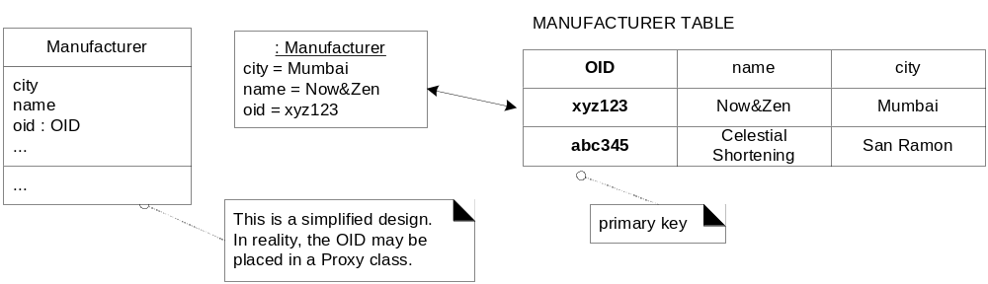
Fig. 38.3

Slide 8

Fig. 38.3

Slide 9
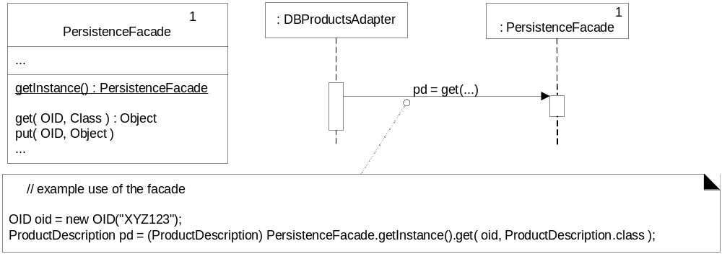
Fig. 38.4

Slide 10

Fig. 38.4

Slide 11
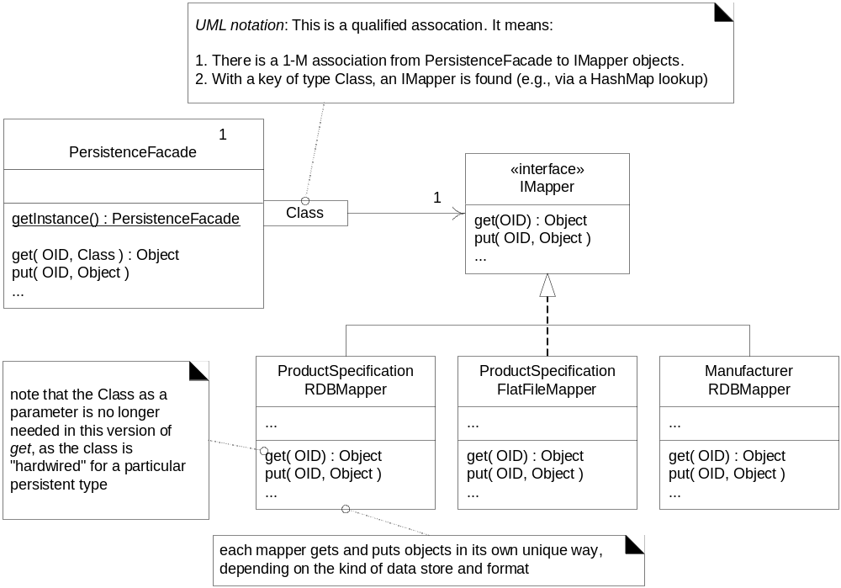
Fig. 38.5

Slide 12

Fig. 38.5

Slide 13
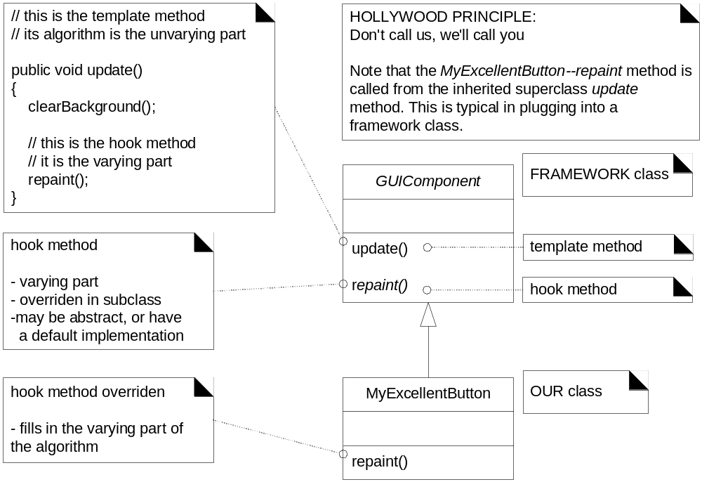
Fig. 38.6

Slide 14

Fig. 38.6

Slide 15
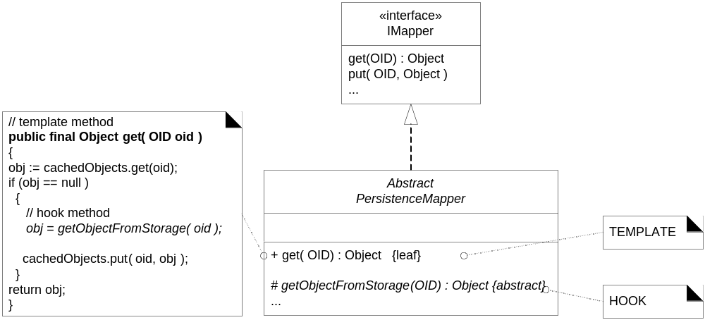
Fig. 38.7

Slide 16

Fig. 38.7

Slide 17
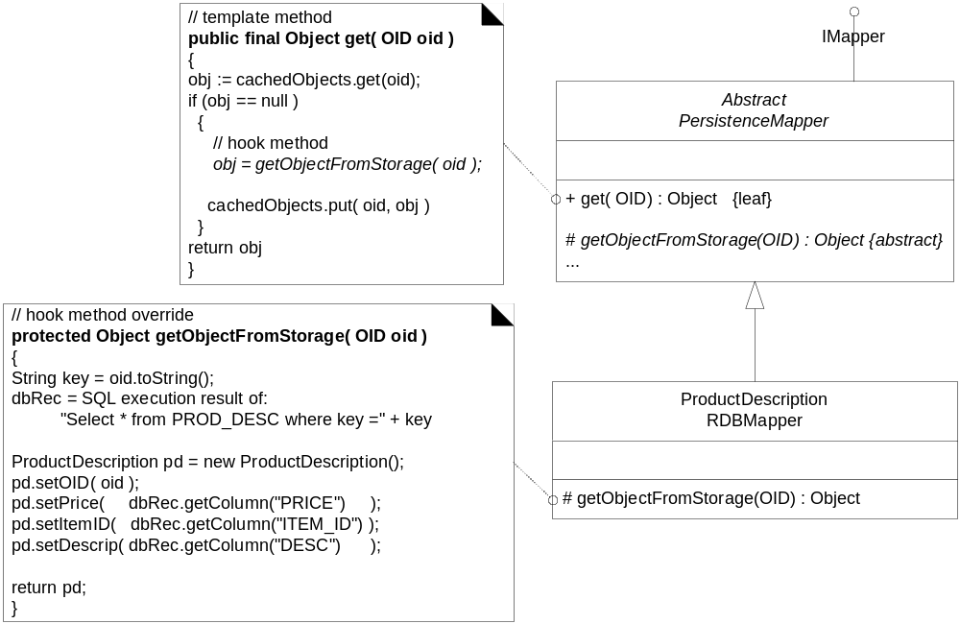
Fig. 38.8

Slide 18

Fig. 38.8

Slide 19
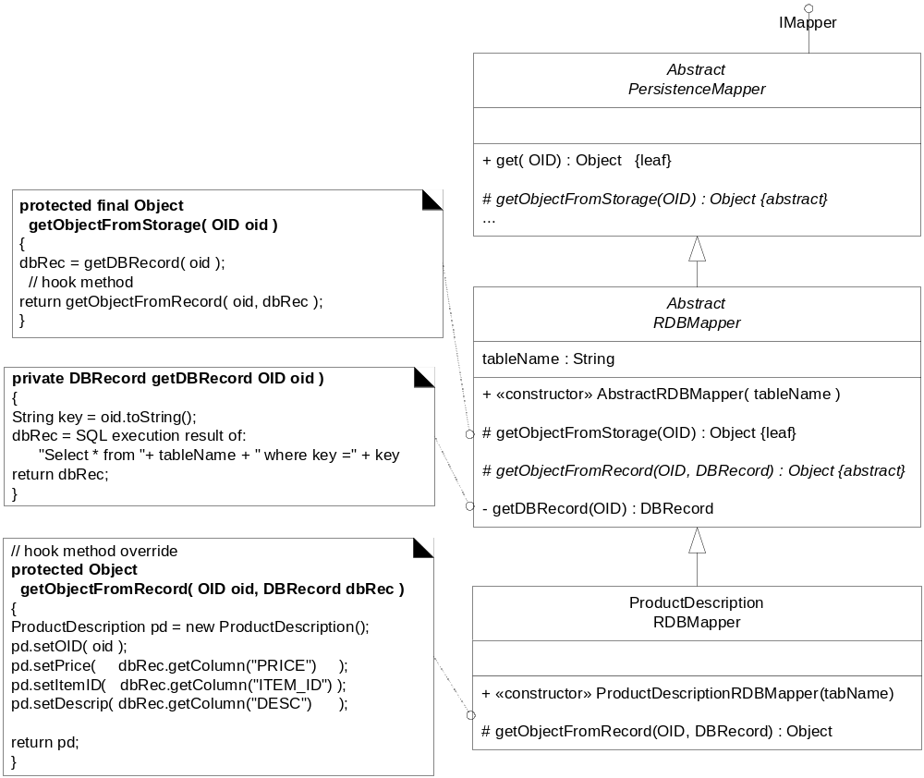
Fig. 38.9

Slide 20

Fig. 38.9

Slide 21
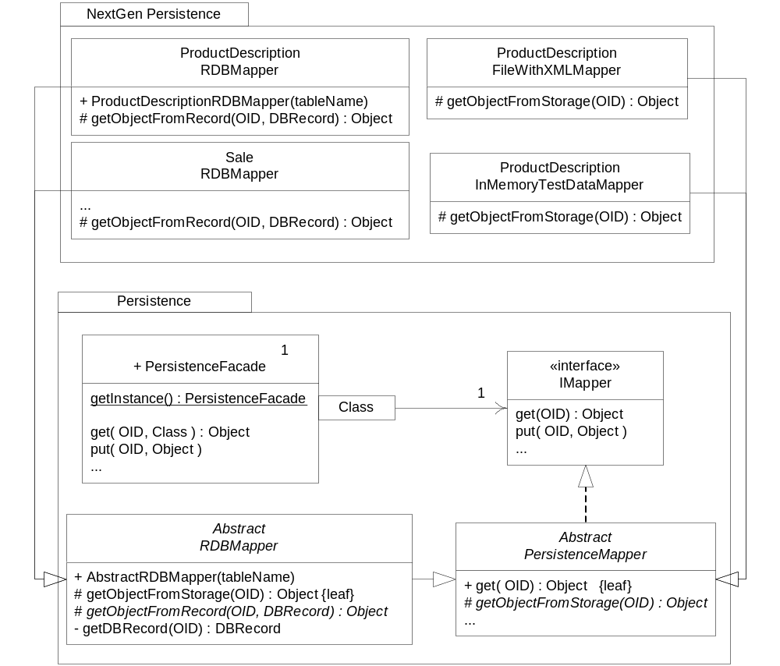
Fig. 38.10

Slide 22
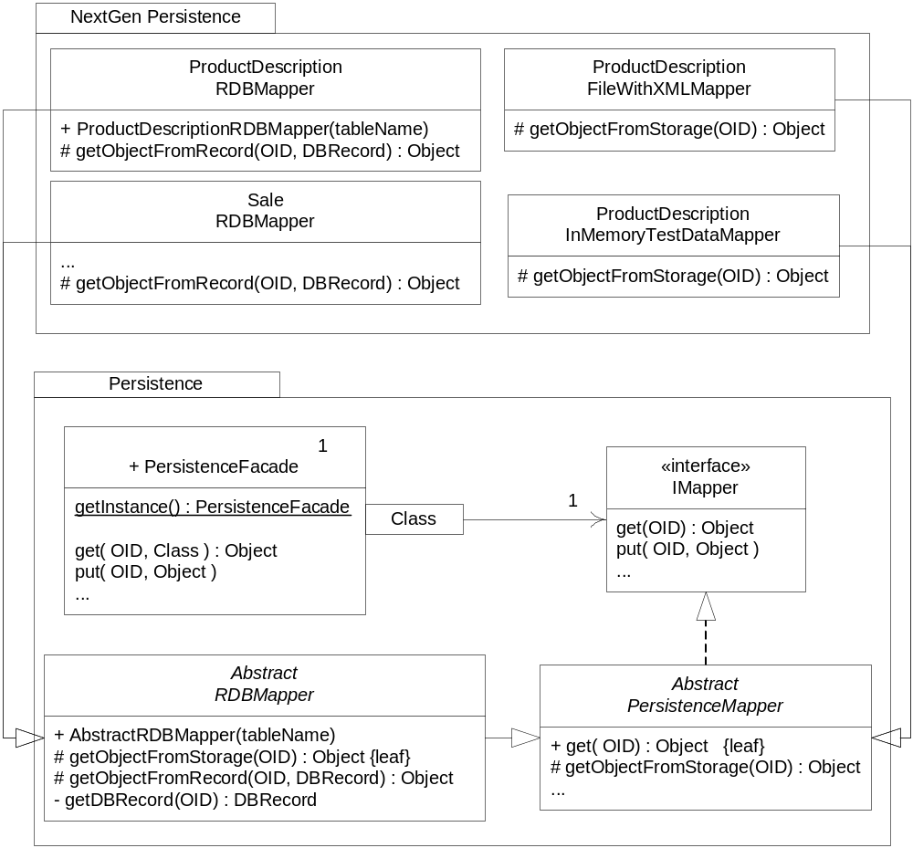
Fig. 38.10

Slide 23
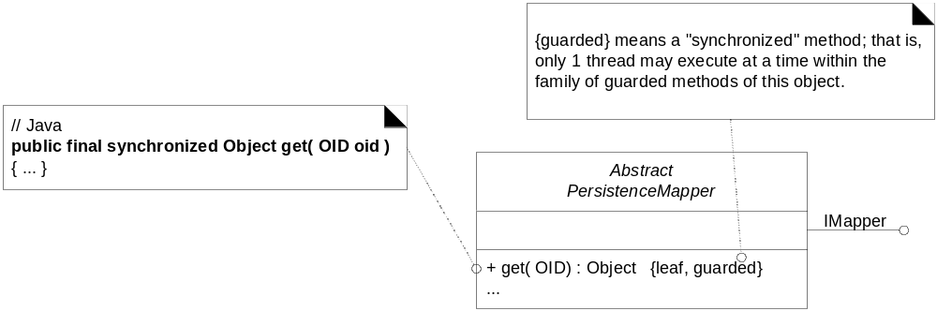
Fig. 38.11

Slide 24
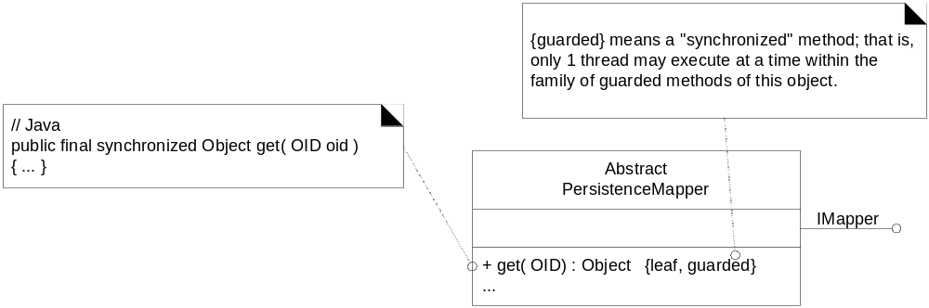
Fig. 38.11

Slide 25
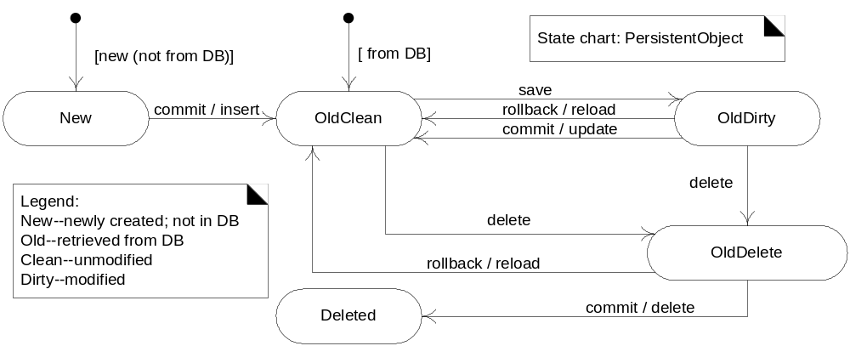
Fig. 38.12

Slide 26
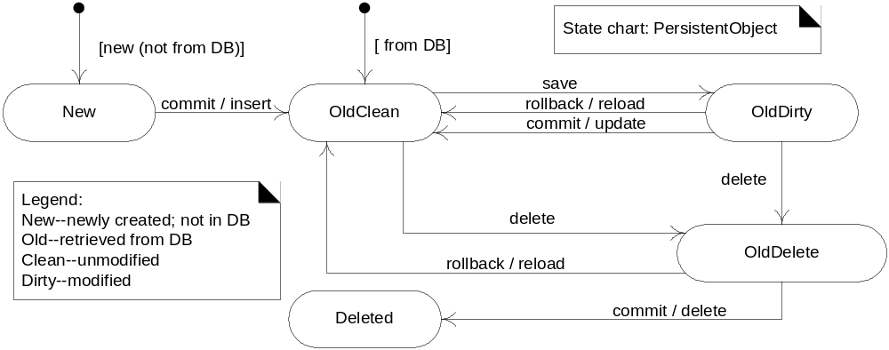
Fig. 38.12

Slide 27
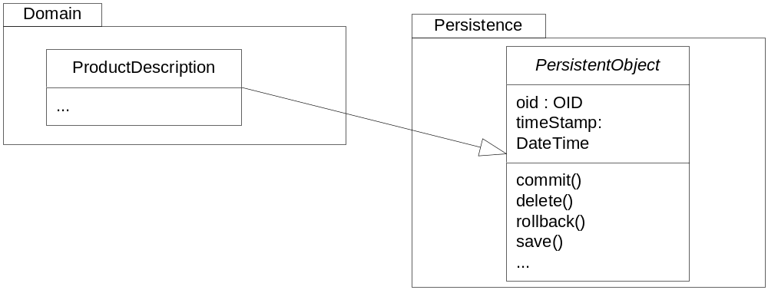
Fig. 38.13

Slide 28
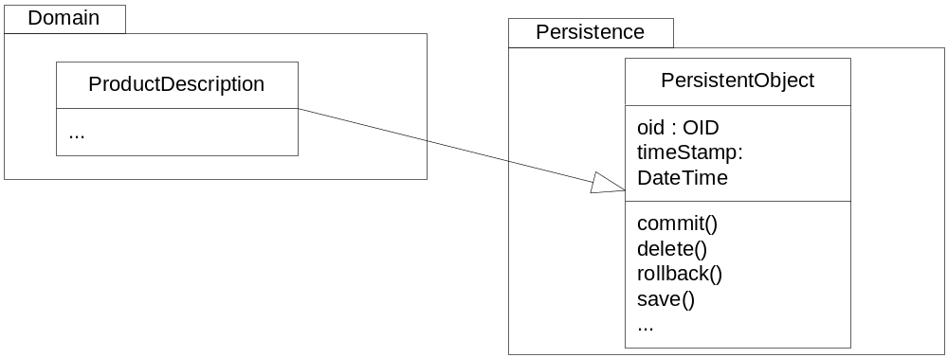
Fig. 38.13

Slide 29
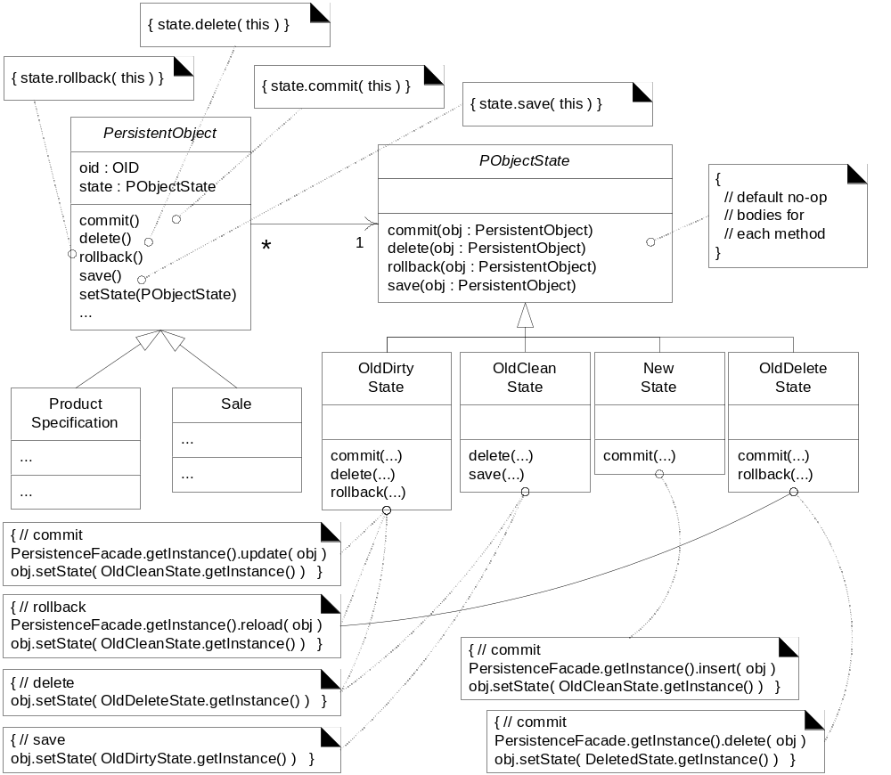
Fig. 38.14

Slide 30
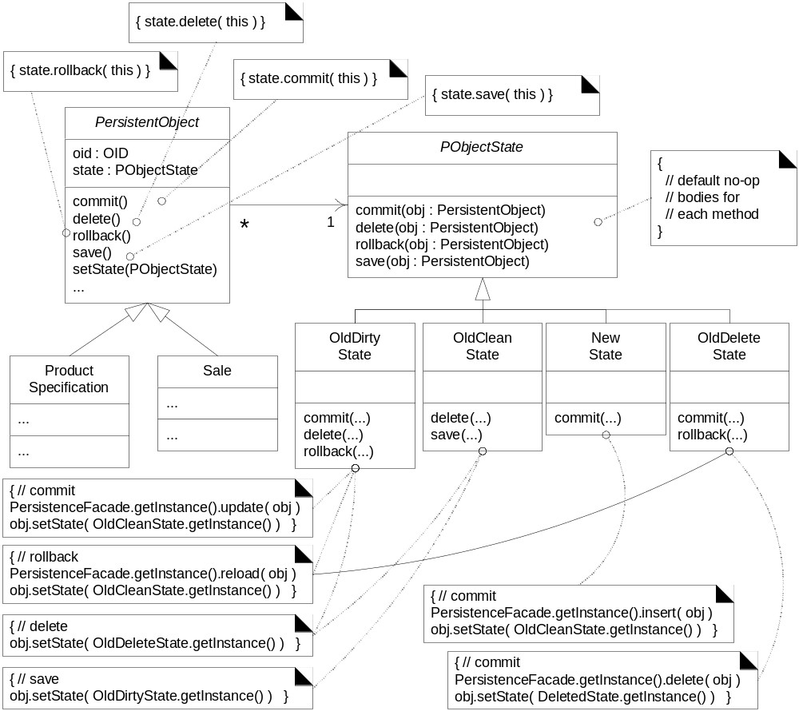
Fig. 38.14

Slide 31
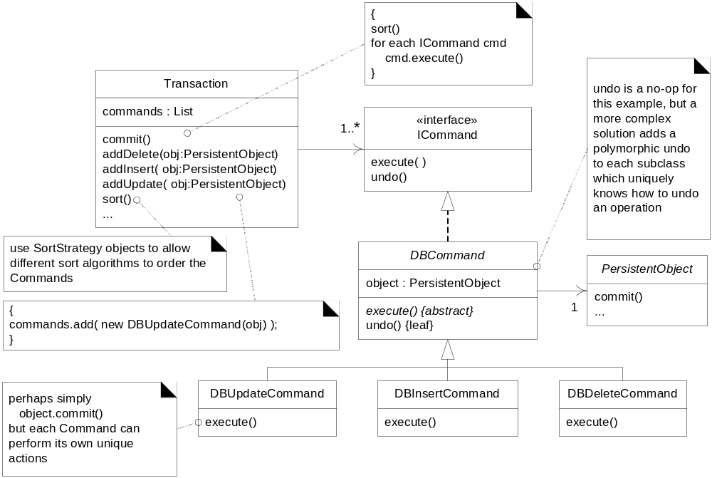
Fig. 38.15

Slide 32

Fig. 38.15

Slide 33
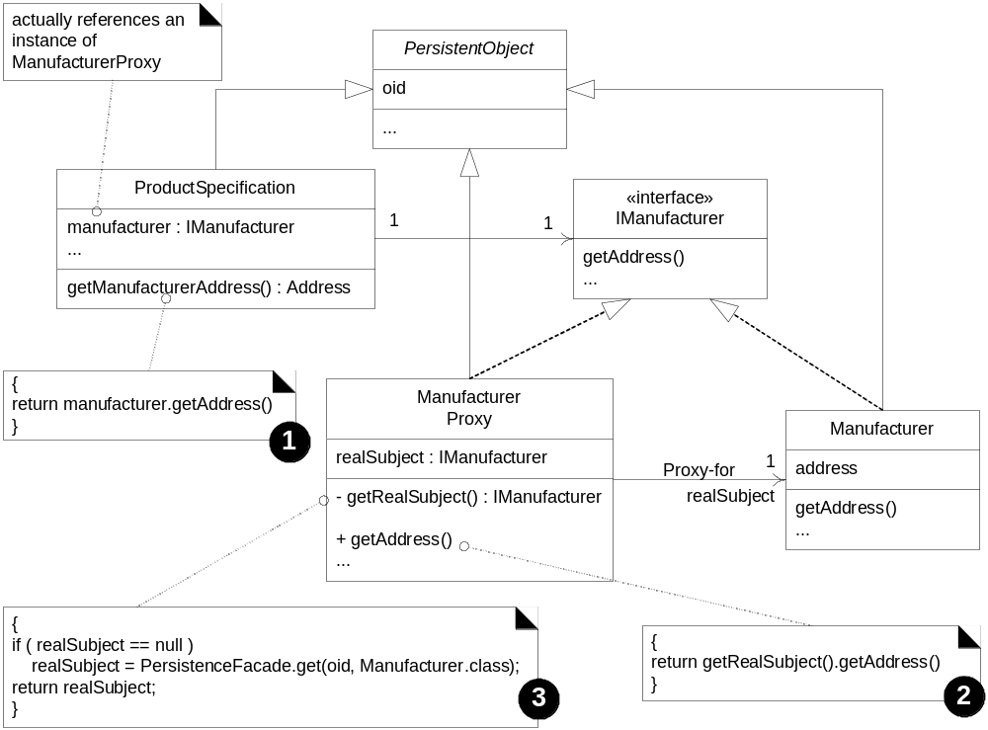
Fig. 38.16

Slide 34

Fig. 38.16

Slide 35
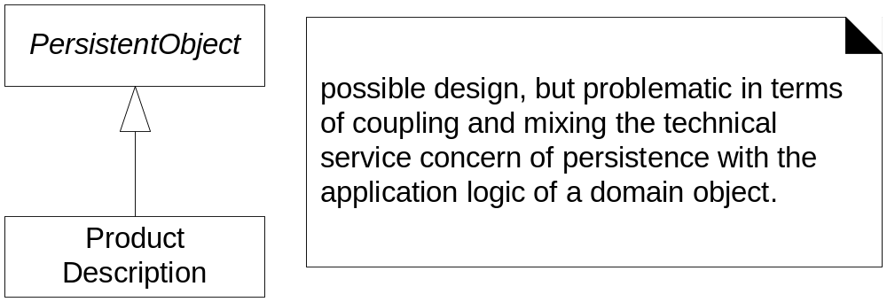
Fig. 38.17

Slide 36

Fig. 38.17

